Slide 1

Team Details
Team Name: The Achievers
Team Leader Name:
Problem Statement: The high cost of smart agriculture technologies, like advanced sensors and data analysis platforms, creates a barrier to entry for small and marginal farmers.

Slide 2
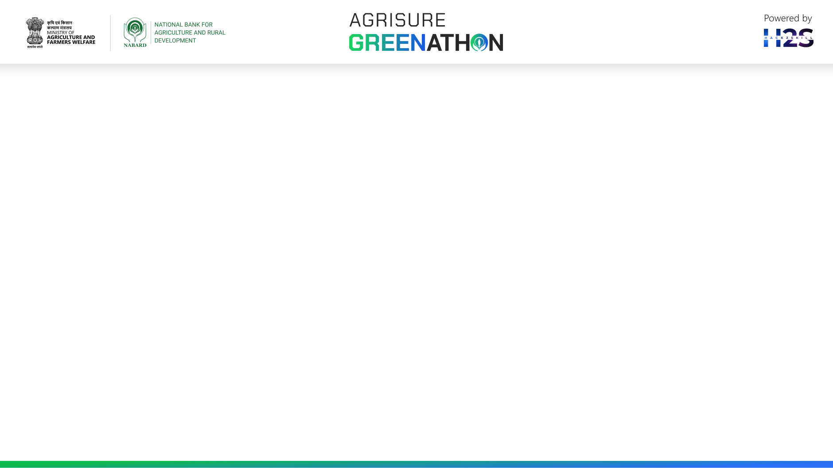
Brief about the idea
Smart Agriculture on a Budget aims to make advanced farming technologies accessible to small and marginal farmers. High costs of sensors and data platforms create barriers, leading to suboptimal resource use, limited real-time data access, and lower productivity. The solution involves developing affordable sensors, DIY drones, mobile apps, community data-sharing platforms, and educational initiatives. Pilot programs, partnerships, and government support will help implement these solutions. The goal is to empower farmers with cost-effective tools to enhance productivity and income.

Slide 3
Opportunities
How different is it from any of the other existing ideas?
How will it be able to solve the problem?
USP of the proposed solution
1. Cost-Effectiveness
Accessibility
Community-Centric Approach
Sustainability
Educational Support
2. Affordable Sensor Technology
DIY Drones
Mobile Applications
Community Data Sharing
Educational Initiatives

Slide 4
3. Affordable Technology
User-Friendly Apps
Community Data Sharing
Sustainable Practices
Educational Support

Slide 5
List of features offered by the solution
Features Offered by the Smart Agriculture on a Budget Solution
1. Low-Cost Sensors:
Soil Moisture Sensors
Nutrient Sensors
2. DIY Drones:
Crop Monitoring
3. Mobile Applications:
Weather Forecasting
Pest Identification
Crop Management Tips
4. Community Data Sharing Platforms
Data Exchange
Local Language Support

Slide 6
5. Open-Source Software
Data Analysis
Farm Management
6. Educational Initiatives
Training Programs
Extension Services
7. Sustainable Practices
Composting
Crop Rotation and Polyculture
8. Support and Partnerships
Pilot Programs
Government and NGO Partnerships

Slide 7
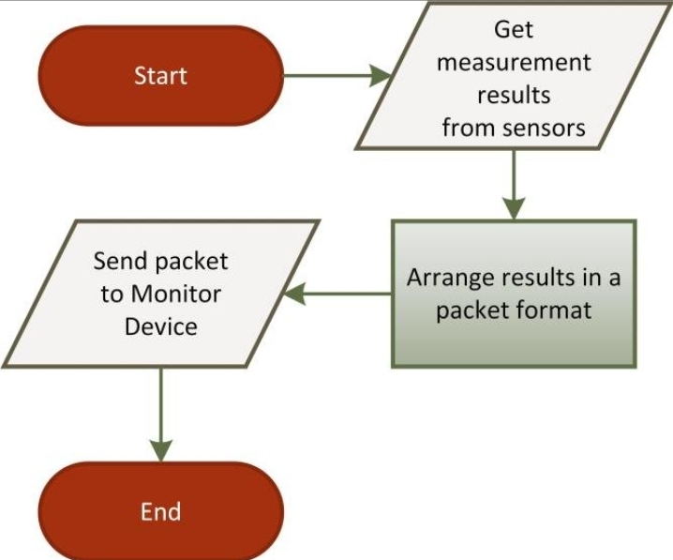
Process flow diagram or Use-case diagram

Slide 8
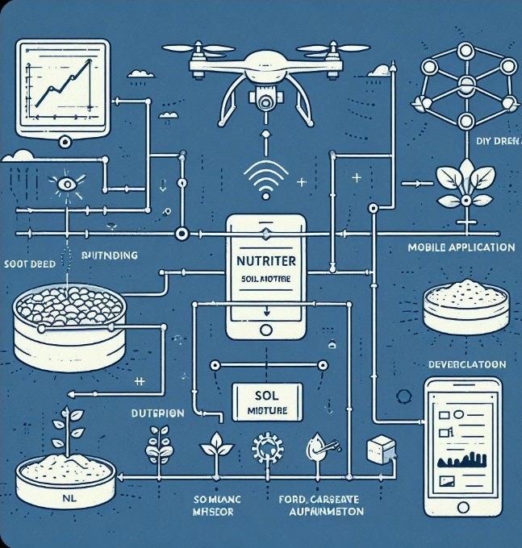
Wireframes/Mock diagrams of the proposed solution (optional)

Slide 9
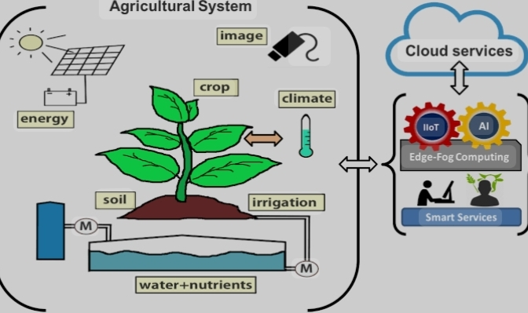
Architecture diagram of the proposed solution

Slide 10
Technologies to be used in the solution
1.Artificial intelligence
2.Machine Learning
3.IoT

Slide 11
Estimated implementation cost (optional)

Slide 12
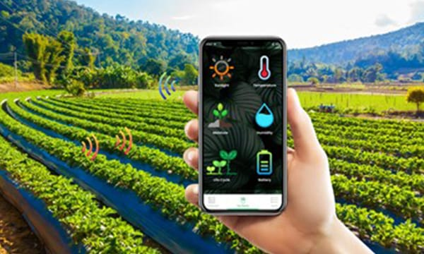
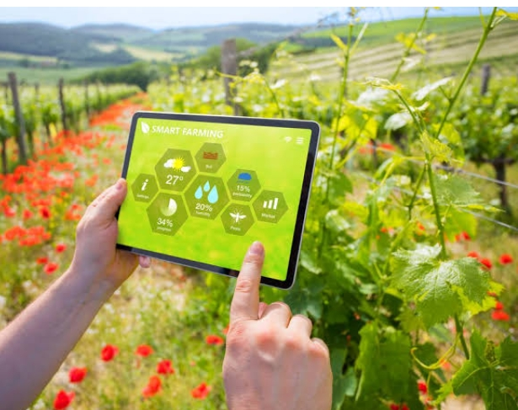
Snapshots of the prototype

Slide 13
Prototype Performance report/benchmarking
1. Introduction
Objective: To develop a cost-effective smart agriculture system that monitors soil moisture, temperature, humidity, and light for small and marginal farmers.
Components Used: Arduino/Raspberry Pi, soil moisture sensor, DHT11/DHT22 sensor, light sensor, ESP8266 Wi-Fi module, solar power setup.
2. System Description
Hardware Configuration: Detailed list of components and their connections.
Software Configuration: Overview of the code, data logging, and visualization methods used.
3. Performance Metrics
Accuracy: Comparison of sensor readings with standard reference instruments.
Reliability: Assessment of system performance under different environmental conditions.
Cost Analysis: Total cost of the prototype compared to commercial solutions.
User Feedback: Feedback from small and marginal farmers on usability and usefulness.

Slide 14
Additional Details/Future Developments

Slide 15
GitHub Public Repository Link & Demo Video Link

Slide 17


